Slide 1
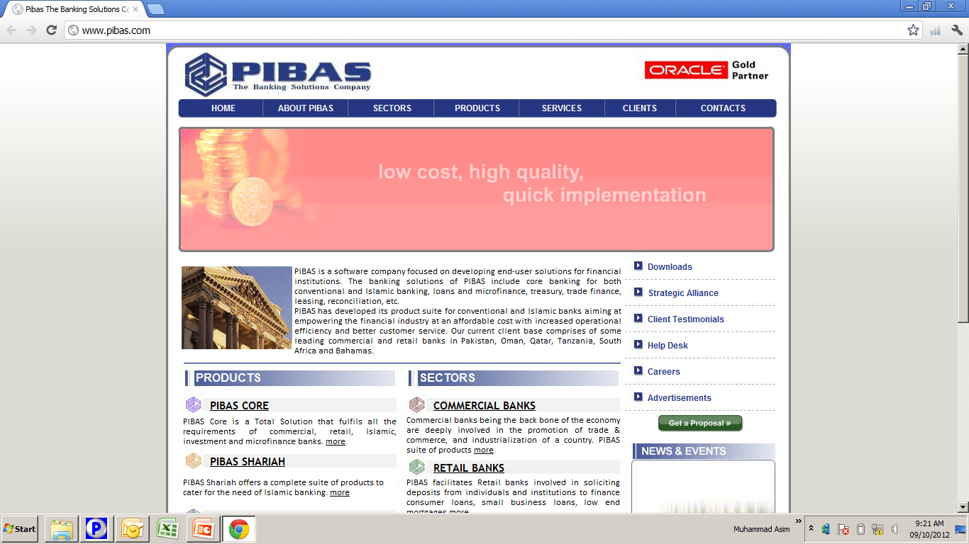
Bank Guarantee
Bank Guarantee /
Letter of Guarantee (LG)
Important Note:
NIC Data along with Bin will be used for this training.

Slide 2
Contents
Bank Guarantee
Bank Guarantee Maintenance
Bank Guarantee Supervision
Parameter Maintenance
Customer Limits
Document Maintenance
Terms of Guarantee
Customer Summary
Guarantee Type Wise Report
Overdue Guarantees Report
Pending Guarantee Report
Matured Ladder Report
Maintenance Report

Slide 3
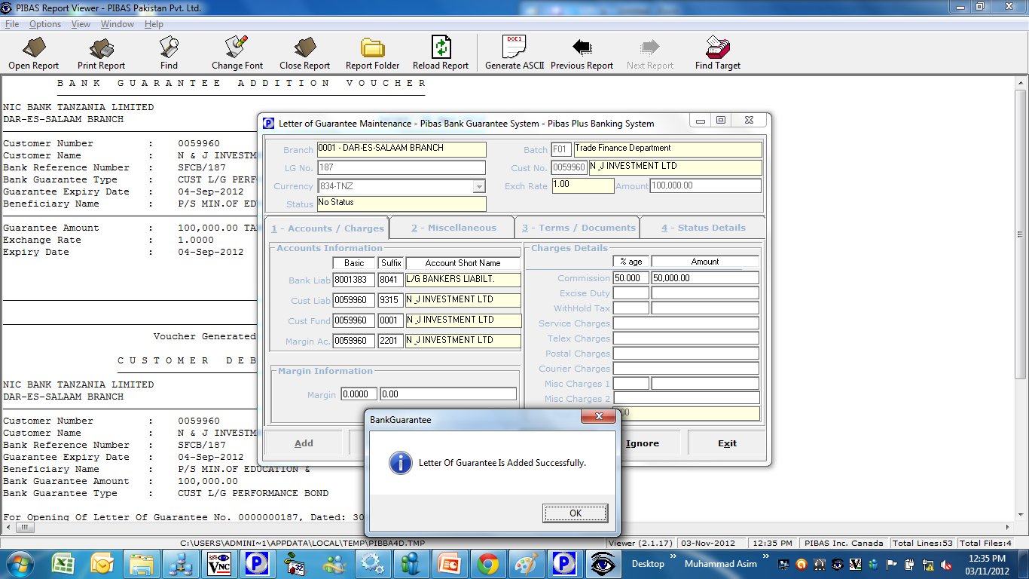
Bank Guarantee
Bank Guarantee Maintenance
How To Process / Important Points To Be Noted Before This Option
Bank Guarantee Definition: A guarantee from a lending institution (Bank) ensures that the liabilities of a debtor will be met. In other words, if the debtor fails to settle a debt, the bank will cover it.
Before this option, customer three types of accounts should be opened 1. Funding / Current / Saving Account 2. Customer Liability Account with suffix 9315 and Account Type 561. 3 Margin Account with suffix 2201 and Account Type 103.

Slide 4
Bank Guarantee
Bank Guarantee Supervision
How To Process / Important Points To Be Noted Before This Option
Same option will be used for supervision
Upon supervision of this transaction a LG Voucher will be appeared but transactions will be executed in shadow but will not appear in Transaction Review. After end of day these will be shown in statement of accounts and in different reports.

Slide 5
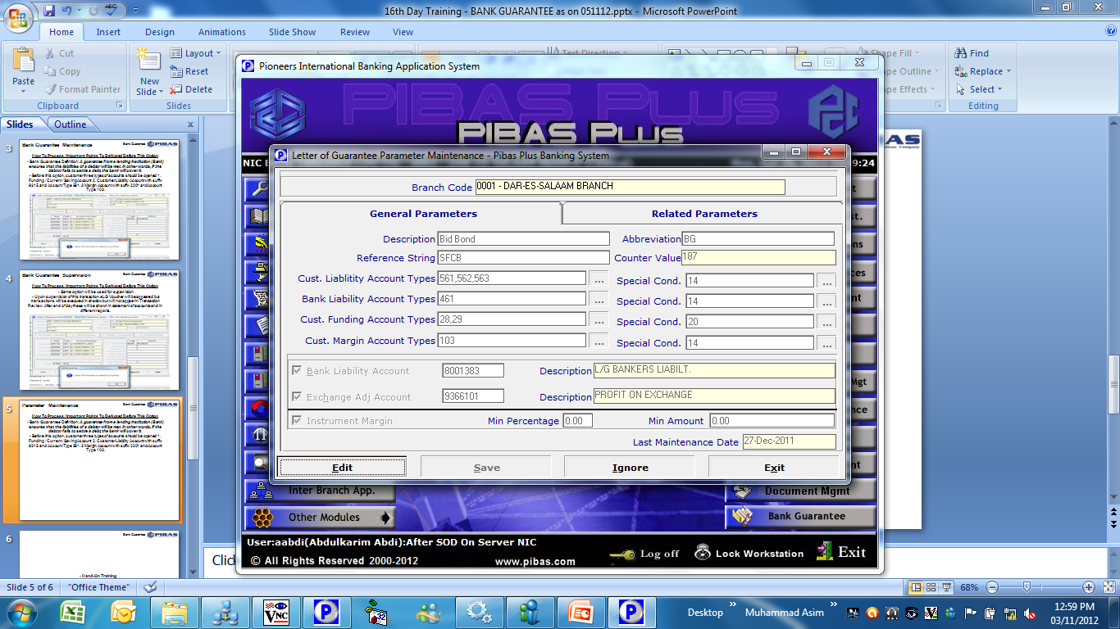
Bank Guarantee
Parameter Maintenance
How To Process / Important Points To Be Noted Before This Option
Following parameters could be defined that may vary due to different policies of banks / central banks.

Slide 6
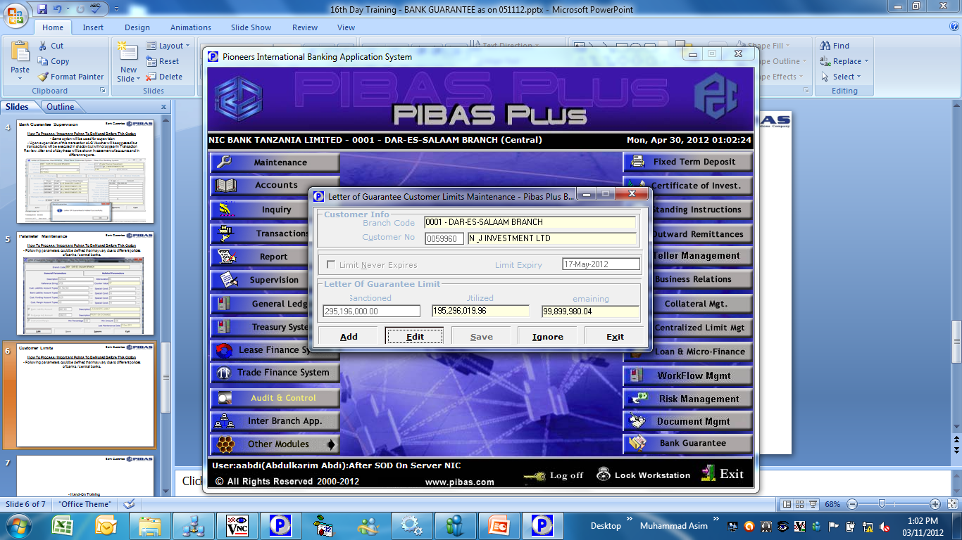
Bank Guarantee
Customer Limits
How To Process / Important Points To Be Noted Before This Option
Through this screen LG Limits could be defined / amended / viewed.

Slide 7
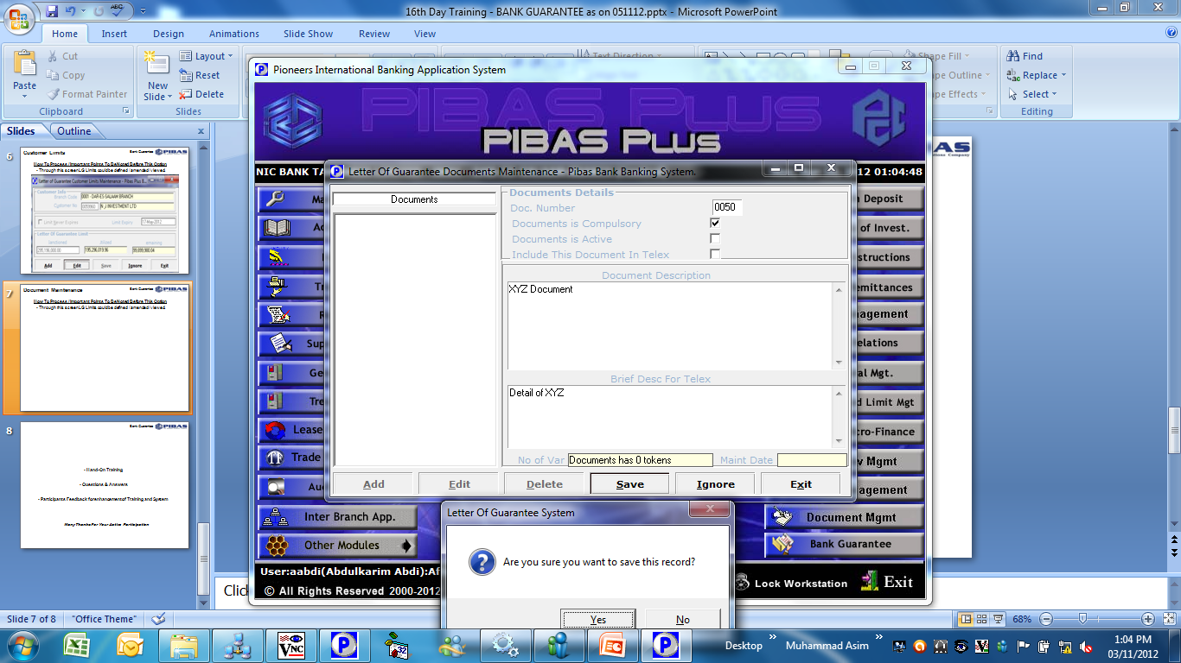
Bank Guarantee
Document Maintenance
How To Process / Important Points To Be Noted Before This Option
In this parameter, different documents could be defined as per policy of bank. These documents are usually required by banks at the time of opening of LG..

Slide 8
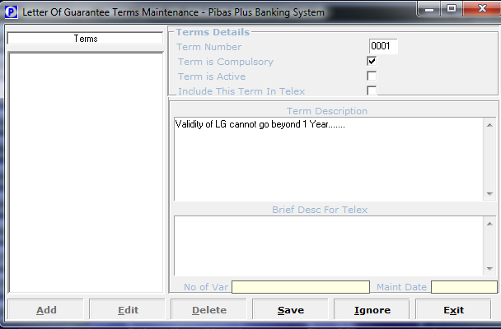
Bank Guarantee
Terms of Guarantee
How To Process / Important Points To Be Noted Before This Option
In this parameter, different terms could be defined as per policy of bank. These terms are usually required by banks at the time of opening of LG..

Slide 9
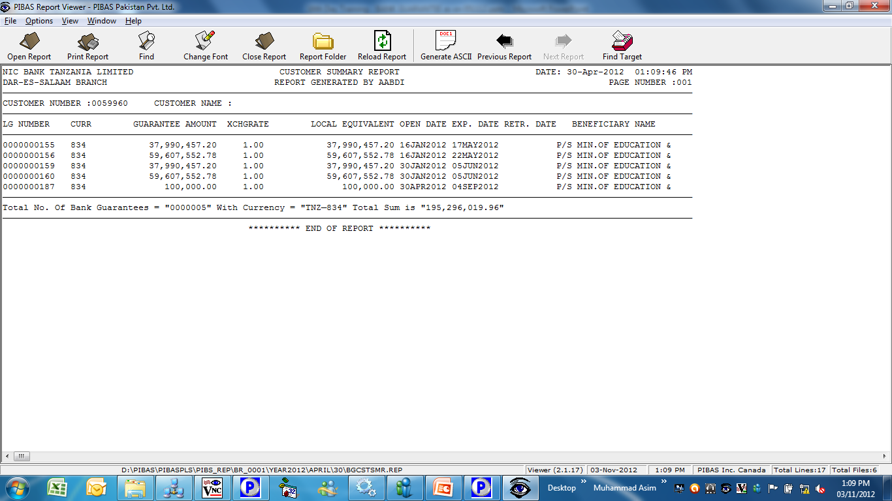
Bank Guarantee
Customer Summary
How To Process / Important Points To Be Noted Before This Option
This report provides a comprehensive information of all LGs of a single customer

Slide 10
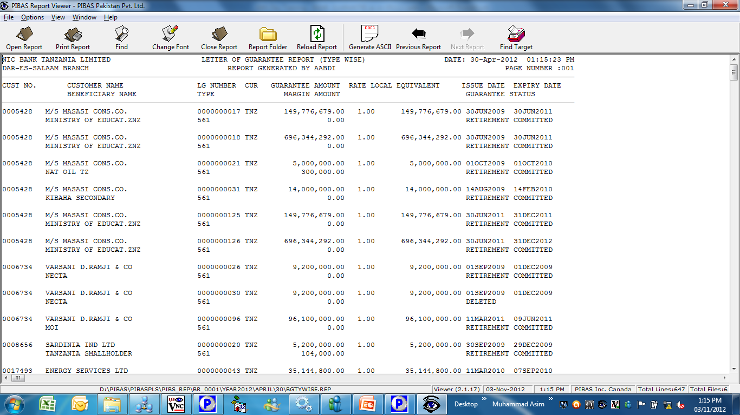
Bank Guarantee
Guarantee Type Wise Report
How To Process / Important Points To Be Noted Before This Option
This report provides a comprehensive information of all LGs of all customers

Slide 11
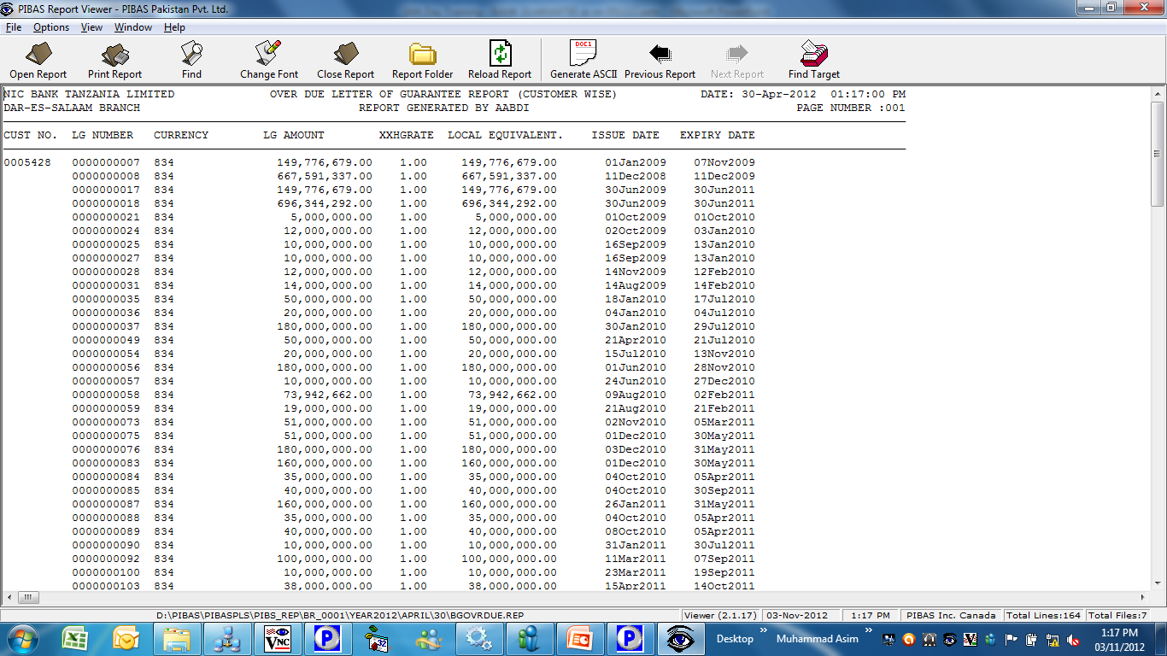
Bank Guarantee
Overdue Guarantees Report
How To Process / Important Points To Be Noted Before This Option
This report provides a comprehensive information of overdue LGs

Slide 12
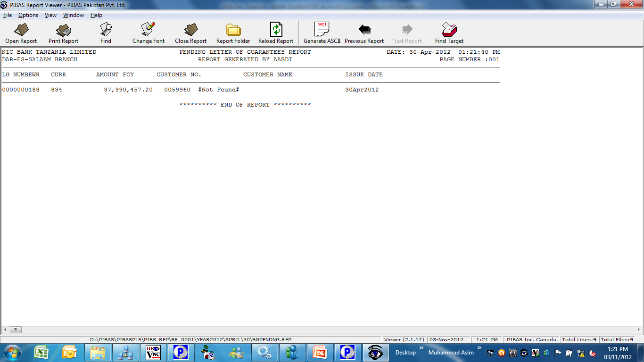
Bank Guarantee
Pending Guarantee Report
How To Process / Important Points To Be Noted Before This Option
This report provides detail of all un-supervised / un-approved LGs

Slide 13
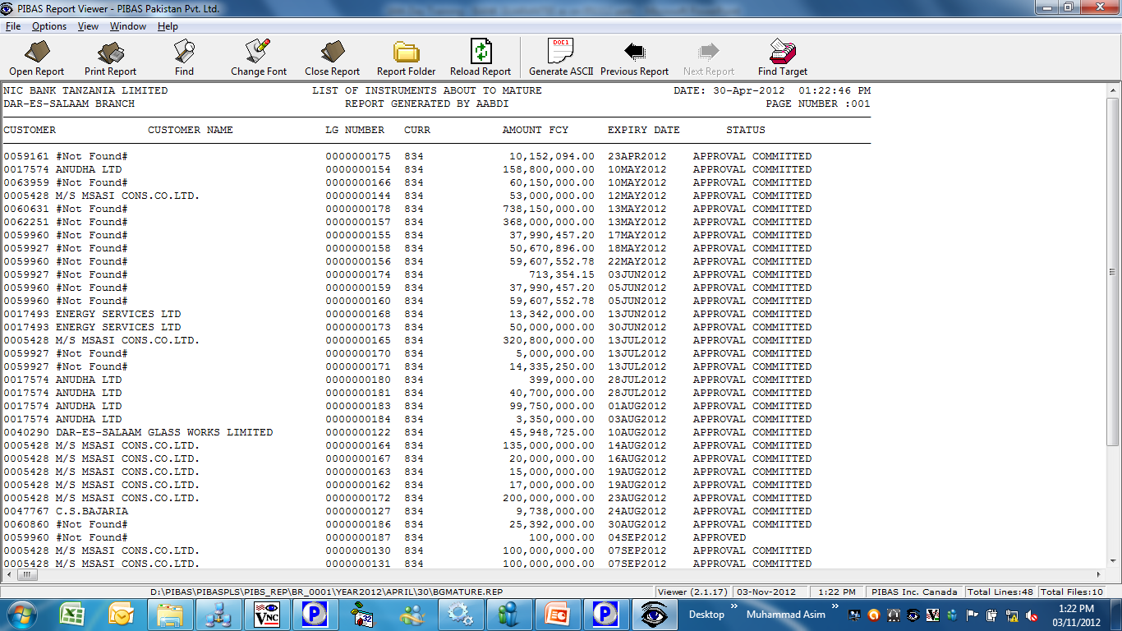
Bank Guarantee
Matured Ladder Report
How To Process / Important Points To Be Noted Before This Option
This report provides detail of all About to Mature LGs

Slide 14
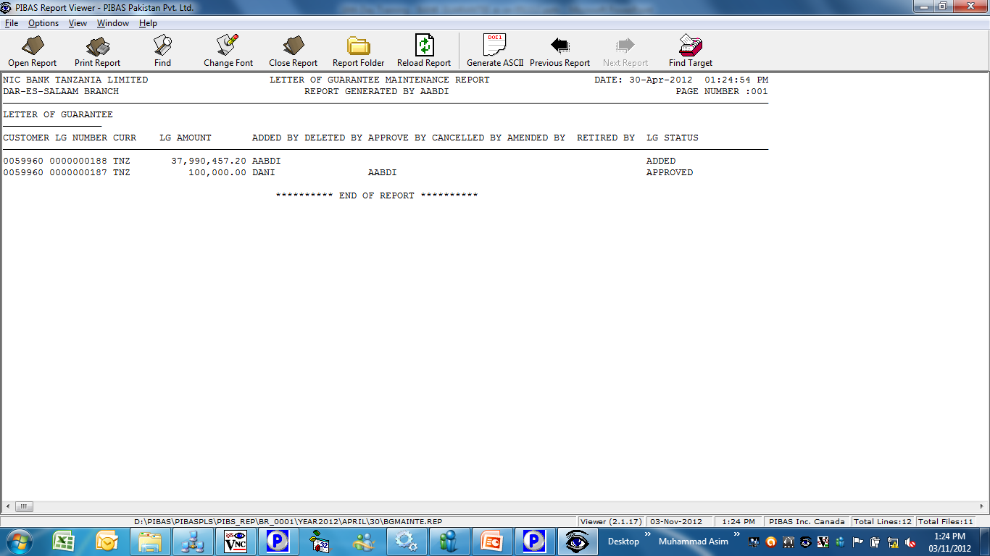
Bank Guarantee
Maintenance Report
How To Process / Important Points To Be Noted Before This Option
This report provides detail of all LGs Maintained During A Day

Slide 15
Bank Guarantee
Hand-On Training
Questions & Answers
Participants Feedback for enhancement of Training and System
Many Thanks For Your Active Participation

